Slide 1

Kannada Chatbot : A Transformer Based Approach
Authors: Angad Sandhu, Isha Nema, Arisetty Sree Ashish, Musica Supriya

Slide 2
Introduction
Indian Subcontinent is home to about 121 separate languages, each with its own inner workings and structures.
Chatbots have been trained in various languages, such as English, French, and Russian. Multilingual chatbots trained in niche Indic languages, the language barrier obstructing native speakers from accessing important information can be overcome.
The purpose of this chatbot is to assist Kannada-speaking farmers to have a better connect with vendors by eliminating the need for a middleman for translation.

Slide 3
Literature Survey
In Kiruthika et al., the system collects details of the farmer, land, and cultivated crops and maintains a database. A function queries the database, retrieves the information, and suggests it to the user based on a condition [1].
NLP techniques used by Vijayalakshmi et al. conversational assistants to comprehend user inquiries in their native tongue. [3]
The system by Yashaswini et al. gets information from government websites and repositories. This information is cleaned to remove any noise and undesired, unrelated information before being safely stored in a database. It is trained thoroughly using machine learning in TensorFlow architecture using the KNN algorithm [5].

Slide 4
Methodology
Two Techniques for creating chatbots are: Simple Chatbot, Intelligent Chatbot
Hybrid Chatbot implementation has been proposed in this paper.
Hybrid Chatbots take advantages of both simple and intelligent chatbots

Slide 5
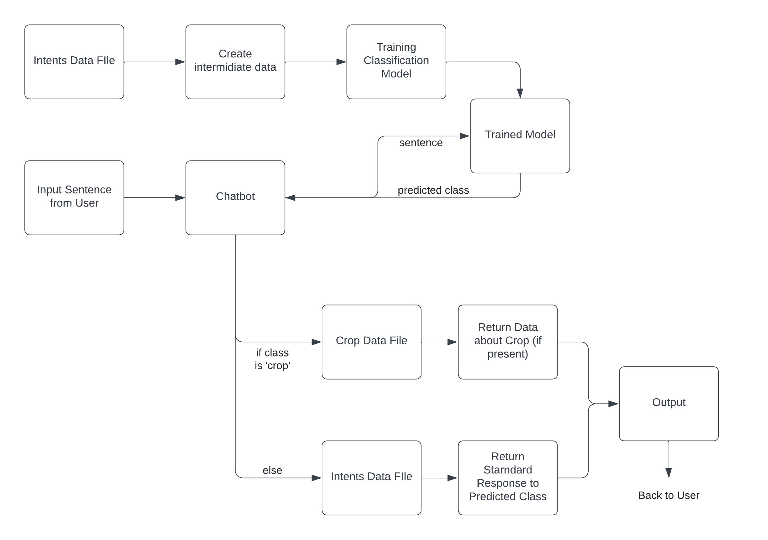
Methodology Flow

Slide 6
Data Collection
The first step of the data collection process used in the present study was to retrieve or create a set of fixed questions and answers as used by classical chatbots.
All sets of questions and answers were distributed within a predefined number of classes.
After all such classes were created, the data was put into a JSON file
The file is a list of dictionaries with 3 attributes - tag, patterns and responses.

Slide 7
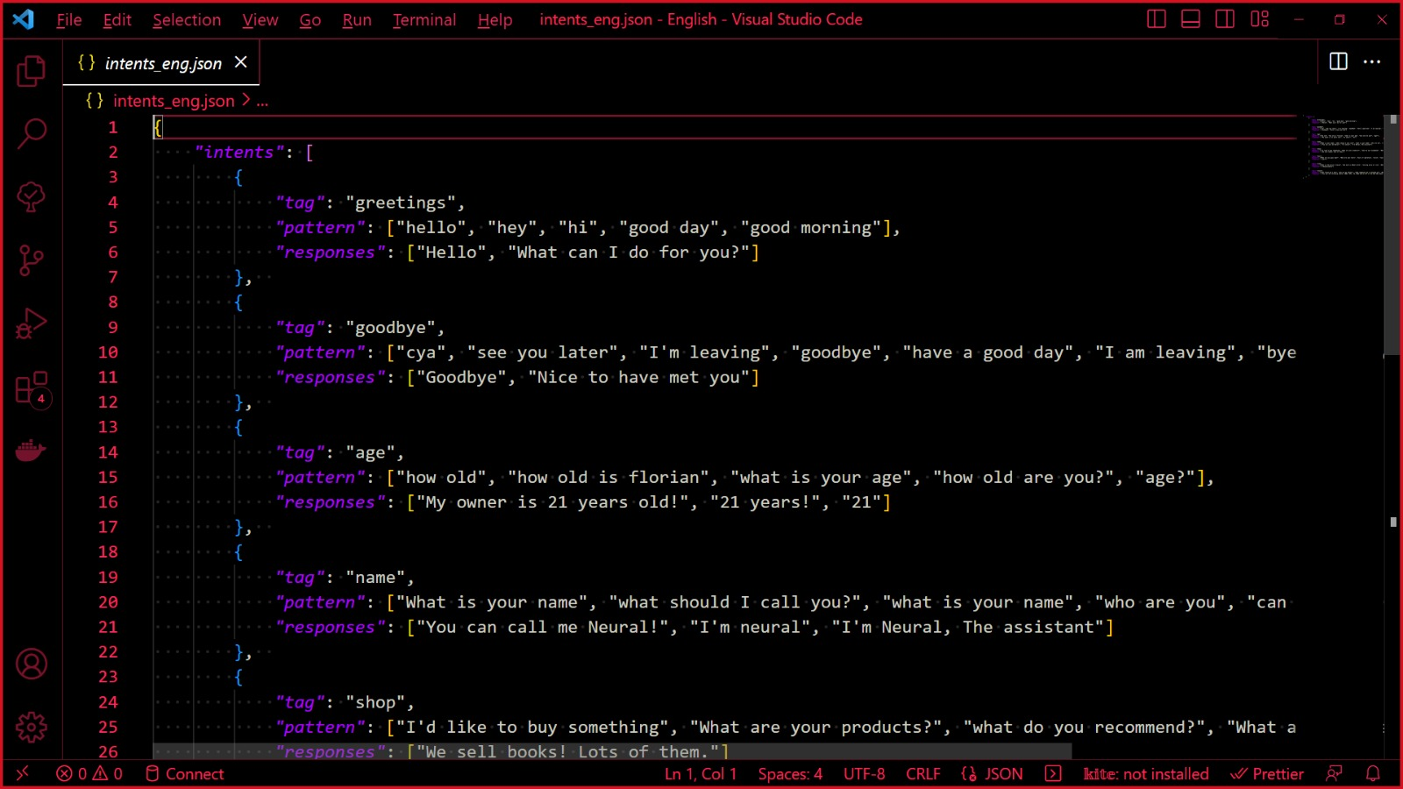
Intents.json

Slide 8
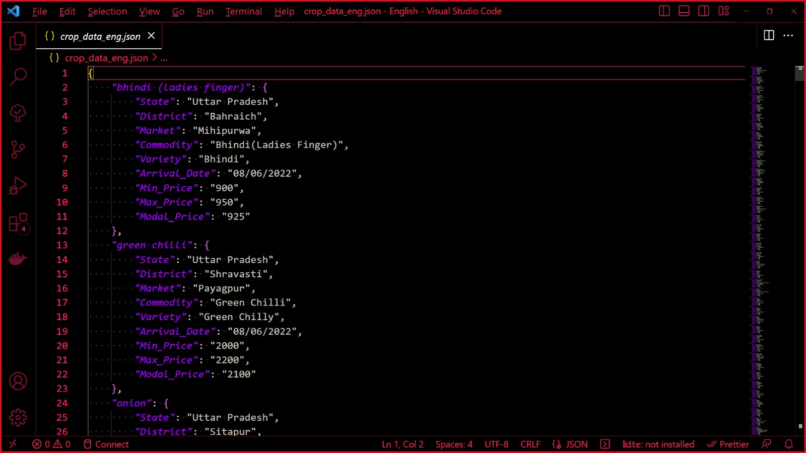
crop-data.json

Slide 9
Analysis
Create intermediate data structures (would be used later in training):
- “words” is a list of all patterns broken down into individual words and appended together
“classes” is a list of all 7 class names
“docs” is a list of tuples with individual patterns and their corresponding classes.
stopwords are removed, data frame is shuffled, split into “Training” and “Validation” sets.
The text data is passed and tokens are converted to one-hot encoding for representation.

Slide 10
Evaluation
After the model is trained and ready to use, the chatbot is implemented.
The chatbot scans the input sentence and passes through the model to generate a list of classes with their corresponding probabilities.
The class with the highest probability is considered.
Response is returned to the predicted class as the answer to the input sentence.

Slide 11
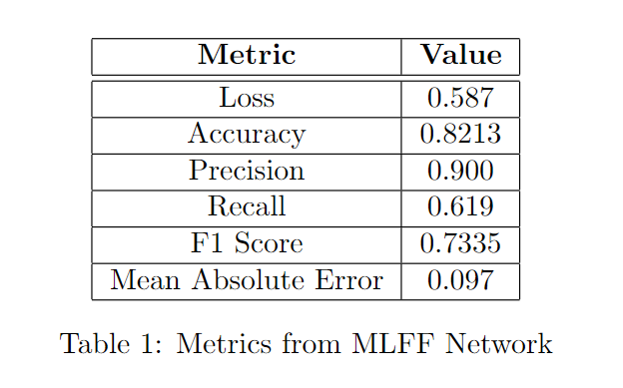
MLFF Network

Slide 12
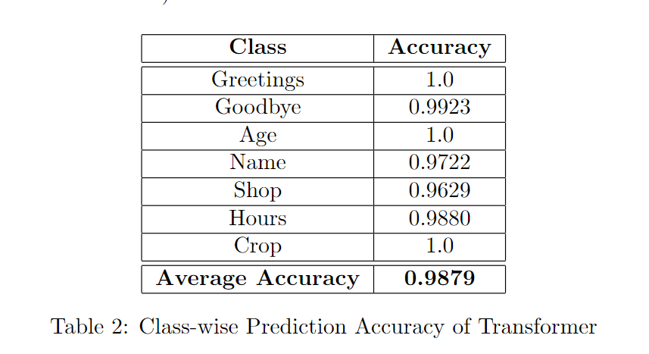
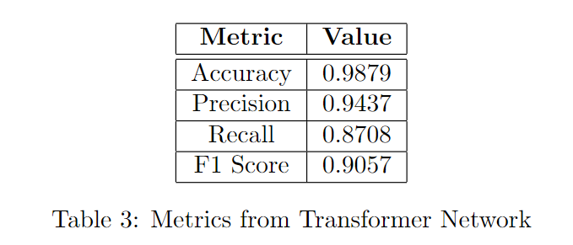
Transformer Network

Slide 13
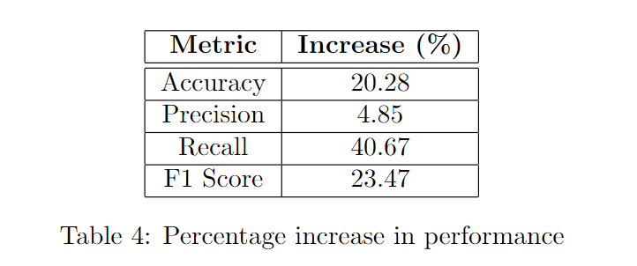
Accuracy Difference

Slide 14
Conclusion
Based on a quantitative and qualitative analysis of current processes to create hybrid chatbots, it can be concluded that such chatbots can be constructed using technologies such as MLFF and Transformer networks. The results indicate that attention-based implementations are much better suited for synthesizing such chatbots.
Based on these conclusions, practitioners should consider using these models for websites or applications with significant traffic from people belonging to diverse cultures.
The next iteration of this research could be focused on creating an intelligent system that identifies the users’ preferred language and automatically loads up a chatbot of that language.

Slide 15
References
[1] Simran Khanuja et al. “Muril: Multilingual representations for indian languages”. In: arXiv preprint arXiv:2103.10730 (2021).
[2] Usha Kiruthika et al. “E-agriculture for direct marketing of food crops using chatbots”. In: 2020 International Conference on Power, Energy, Control and Transmission Systems (ICPECTS). IEEE. 2020, pp. 1–4.
[3] Gustavo Marques Mostaco et al. “AgronomoBot: a smart answering Chatbot applied to agricultural sensor networks”. In: 14th international conference on precision agriculture. Vol. 24. 2018, pp. 1–13.
[4] S Gracia et al. “Connect Farmer”. In: International Journal of Engineering and Technology(UAE) 7 (Sept. 2018), pp. 181–183. doi: 10.14419/ijet.v7i3.34.18942.
[5] J Vijayalakshmi and K Pandimeena. “Agriculture talk bot using AI”. In: Int. J. Recent Technol. Eng 8 (2019), pp. 186–190.
[6] Brahmananda Reddy D. “Agriculture Chatbot Application Using Python”. In: International Journal of Interdisciplinary Innovative Research and Development (2020).
[7] P Kaviya et al. “Artificial Intelligence Based Farmer Assistant Chatbot”. In: International Journal of Research in Engineering, Science and Management 4.4 (2021), pp. 26–29.
[8] DK Yashaswini, R Hemalatha, and G Niveditha. “Smart chatbot for agriculture”. In: Int J Eng Sci Comput 9 (2019), pp. 22203–22205.
[9] Jayalath Ekanayake and Luckshitha Saputhanthri. “E-AGRO: Intelligent Chat-Bot. IoT and Artificial Intelligence to Enhance Farming Industry”. In: AGRIS online Papers in Economics and Informatics 12.665-2020-1221 (2020), pp. 15–21.
[10] Naman Jain et al. “AgriBot: agriculture-specific question answer system”. In: (2019).
[11] H Manoj T Gadiyar Dr Thyagaraju and GS Poornima. “AI AND CLOUD-BASED SMART FARM ASSIST IN KANNADA FOR COCONUT FARM-ERS”. In: ().
[12] Duygu Altinok. Mastering spaCy: An end-to-end practical guide to implementing NLP applications using the Python ecosystem. Packt PublishingLtd, 2021.

